Slide 1




Dependency Properties and Attached Properties
Attached and Dependency Properties

Slide 2
Table of Contents
Property Elements
Attached Properties
Dependency Properties
Attached Behavior

Slide 3
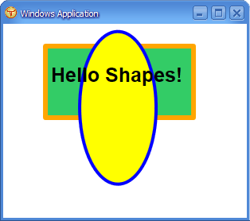
Property Elements

Slide 4
Property Elements
Not all properties have just a string value
Some must be set to an instance of an object
XAML provide syntax for setting complex property values, called property elements
Take the form TypeName.PropertyName contained inside an TypeName element
A property element
<Ellipse>
<Ellipse.RenderTransform>
<RotateTransform Angle="45" CenterY="60" />
</Ellipse.RenderTransform>
</Ellipse>

Slide 5


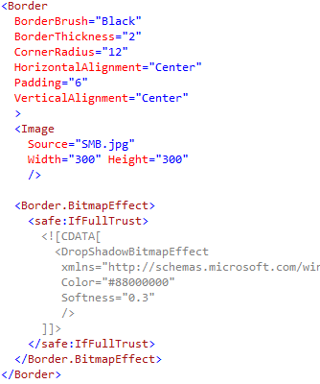
Property Elements
Live Demo

Slide 6
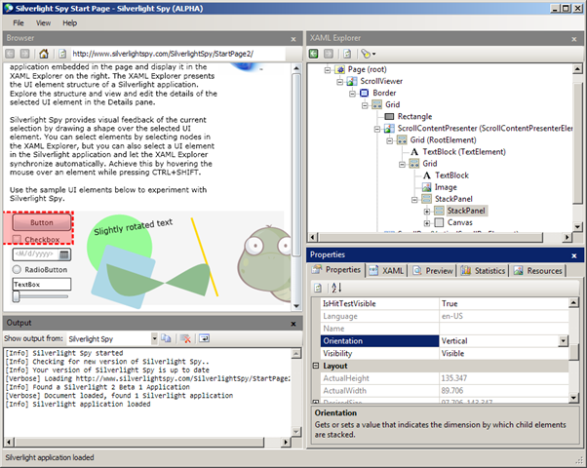
Content Properties

Slide 7
Content Properties
One of the element's properties is default
Known as content property
Typically contains the child elements
Content properties are used without prefix:
A content property
<Border>
<TextBox Width="300"/>
</Border>
<!-- Explicit equivalent -->
<Border>
<Border.Child>
<TextBox Width="300"/>
</Border.Child>
</Border>
A property element

Slide 8
Dependency Object

Slide 9
Dependency Object
The DependencyObject
Represents an object that participates in the dependency property system
Enables WPF / SL property system services
The property system's functions:
Compute the values of properties
Provide system notification about values that have changed
DependencyObject as a base class enables objects to use Dependency Properties

Slide 10
Dependency Object (2)
DependencyObject has the following members:
Get, Set, and Clear methods for values of any dependency properties
Metadata, coerce value support, property changed notification
Override callbacks for dependency properties or attached properties
DependencyObject class facilitates the per-owner property metadata for a dependency property

Slide 11
Dependency Properties
Dependencies

Slide 12
Dependency Properties
Silverlight, WPF and WinRT provide a set of services that can be used to extend the functionality of a CLR property
These services are typically referred to as the Silverlight / WPF/WinRT property system
Dependency Property is a property that is backed by the SL/WPF property system

Slide 13
Dependency Properties (2)
Dependency properties are typically exposed as CLR properties
At a basic level, you could interact with these properties directly
May never find out they are dependency properties
Better to know if a property is Dependency or CLR
Can use the advantages of the dependency properties

Slide 14
Dependency Properties (3)
The purpose of dependency properties is to provide a way to compute the value of a property based on the value of other inputs
Can be implemented to provide callbacks to propagate changes to other properties
Provide two-way data binding with UI controls

Slide 15
Dependency Properties
Live Demo

Slide 16
Attached Properties
How to set properties from another place

Slide 17
Attached Properties
An attached property is intended to be used as a type of global property that is settable on any object
In WPF and Silverlight attached properties are defined as dependency properties
They don't have the wrapper property
Examples of Attached Properties
Grid.Row, Grid.Column, Grid.RowSpan
Canvas.Top, Canvas.Left, Canvas.Bottom

Slide 18
Attached Properties
Live Demo

Slide 19
Creating and Registering Dependency Properties

Slide 20
Custom Dependency Properties
DependencyProperties must be registered in the Property System
Done by the static method DependencyProperty.Register()
The Register() takes few parameters
Name of the property - string
The object type of the property - Type
The type that the property belongs to - mostly UserControl

Slide 21
Custom Dependency Properties
Dependency property can be registered using the following template
or using code snippet propdp
Dependency Property's instance is always readonly
public static readonly
DependencyProperty ScrollValueProperty =
DependencyProperty.Register(
"ScrollValue",
typeof(double),
typeof(UserControl),
null);
The name of the Dependency Property
Registration to the Property System

Slide 22
Dependency Property Registration
Two Register Methods:
Register(String, Type, Type)
Registers a dependency property with the specified property name, property type, and owner type
Register(String, Type, Type, PropertyMetadata)
Add Property metadata
Default value or Callback for Property changes

Slide 23
Dependency Property Wrapper
After the registration of the Dependency Property it needs wrapper
Used to make it look like plain old CLR Property
DependencyObject has two methods used for the wrapping of dependency properties
SetValue(DependenyProperty, value)
GetValue(DependenyProperty)
public double ScrollValue
{
get { return (double)GetValue(ScrollValueProperty); }
set { SetValue(ScrollValueProperty , value); }
}

Slide 24
Creating and Registering Dependency Properties
Live Demo

Slide 25
Creating and Registering Attached Properties
How to make attached properties?

Slide 26
Custom Attached Properties
The registration of attached properties is a little different than DependencyProperties
Has a code snippet propa
public static Thickness GetMargin(DependencyObject obj)
{
return (Thickness)obj.GetValue(MarginProperty);
}
public static void SetMargin(DependencyObject obj, Thickness val)
{
obj.SetValue(MarginProperty, val);
}
public static readonly DependencyProperty MarginProperty =
DependencyProperty.RegisterAttached("Margin",
typeof(Thickness), typeof(ContentMargin),
new FrameworkPropertyMetadata(default(Thickness),
new PropertyChangedCallback(OnPropertyChanged)));

Slide 27
Custom Dependency and Attached Properties
Live Demo

Slide 28
Attached Behavior
The real usage of Attached Properties

Slide 29
Attached Behavior
Attached behavior is behavior that does not exist on the control by default
i.e. binding a command to a TextBlock
TextBlock does not have a property Command
Attached Behavior is done using Attached Properties
Create an Attach Property that accepts Command

Slide 30
Attached Behavir: Sample
Creating a way to bind a command to the MouseLeftButtonDown event
public static ICommand GetClick(DependencyObject obj) {…}
public static void SetClick(DependencyObject obj,
Icommand value) {…}
public static readonly DependencyProperty ClickProperty =
DependencyProperty.RegisterAttached("Click",
typeof(ICommand),
typeof(CommandsBehavior),
new PropertyMetadata(ExecuteClickCommand));
<TextBlock commandBehavior:CommandsBehavior.Click="{Binding Click}"
Text="Click" />

Slide 31
Attached Behavior
Live Demo

Slide 32
Dependency Properties and Attached Properties
http://academy.telerik.com

